Slide 1
Lean Production
CHIP CRISIS

Slide 2
Define a problem:
A chip is a semiconductor material that exists in every aspect of our lives, from householdappliances to the defense industry, from the automotive industry to technology.
The chip crisis, which entered our lives with the pandemic, has affected the automotive sector mostly.Lack of chip resource in main automotive industries such as Ford ,Hyundai,Volskwagen Toyota caused a break in production for a while.
A shortage in the supply of semiconductors has had a cascading effect, causing global disruption. The shortage can be traced back to the first half of 2020, when overall consumer demand for cars declined during the lockdown.

Slide 3
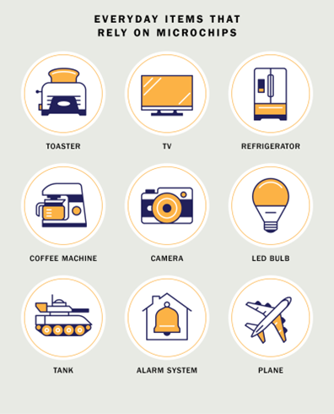
Figure 1: Microchips are used from the automotive industry to the electronic industry. Most of the machines we use regularly in our daily life contain microchips.

Slide 4
WHAT IS A SEMICONDUCTOR CHIP?
A semiconductor chip, also called a microchip, serves as the “brain” of modern electronics. Manufactured from silicon, these highly engineered components are essentially a type of electric circuit. They include a series of transistors that function as tiny switches to control the flow of electrons.
Microchips can differ greatly in their complexity. For example, most credit cards feature a very basic chip as an added security measure. High-end computer processors, on the other hand, are incredibly complex. Today, these chips are used in nearly everything, from cars and smartphones to refrigerators and electric toothbrushes.

Slide 5
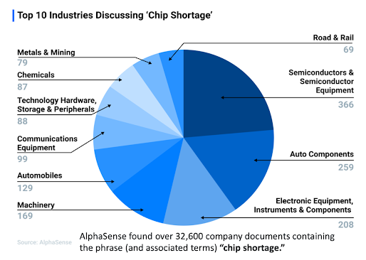
MEASURE:
Figure 2: According to researches, many industries, especially semiconductors, auto components, electronic equipment, suffer from chip shortages.
The lack of semiconductors affects a range of industries, including advertising. The chip shortage is limiting the availability of digital equipment, including lighting and screens for ads.

Slide 6
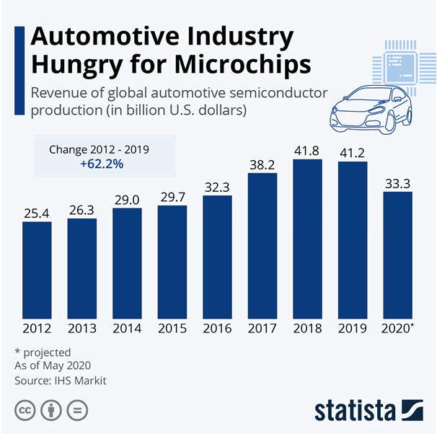
Figure3: We can see from this table how much the revenue has decreased in 2020 due to the chip crisis in the automotive industry.
In 2019, the auto industry spent $43 billion on chips—but they made up just 10% of the total chip market. The world’s largest foundry, Taiwan Semiconductor Manufacturing Company (TSMC), supplies more chips than anyone else to the automotive industry—but the automotive industry makes up just 3% of its revenue. (Apple makes up more than 20%.) At GlobalFoundries, chips destined for cars accounted for less than 10% of its business—enough to matter, but not enough to set the clocks.

Slide 7
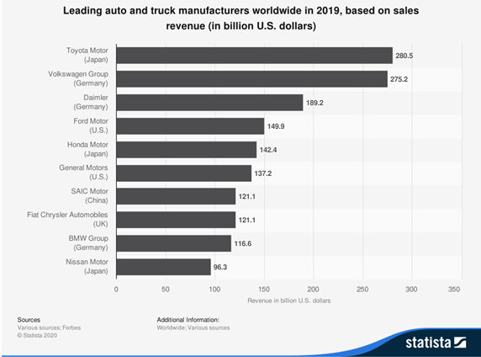
Figure 4: It is seen in the table that the income in 2019 is much more positive than in 2021.
Chip shortage expected to cost auto industry $110 billion in revenue in 2021.The semiconductor chip shortage is expected to cost the global automotive industry $110 billion in revenue in 2021, according to consulting firm AlixPartners. The forecast is up by 81.5% from an initial forecast of $60.6 billion in late January.

Slide 8
How the shortage is affecting firms:
Renault forecasts its car production could be down by about 100,000 this year
Sony says it is difficult for it to bump up production of the PS5 consoles
Apple expects the impact of the shortage to worsen and extend to iPhone production
Tesla says it is using alternative chips and rewriting software
Taiwan Semiconductor Manufacturing plans to build new factories in the US and Japan
Toyota is to slash worldwide vehicle production by 40% in September because of the global microchip shortage.

Slide 9

Figure 6: We see the decrease in the production of cars due to the chip crisis in the table. The production of many vehicles was stopped due to lack of chips.

Slide 10
ANALYSIS:
Supply and Demand Gap
Chinese tech company Huawei had also placed large orders from Taiwan's largest chipmaker TSMC and other Taiwanese manufacturers to secure enough chips before the sanctions went into effect in September. Meanwhile, Taiwanese chip manufacturers have been busy fulfilling orders from the electronics industry due to the increasing demand for laptops, game consoles and smartphones due to the pandemic. On top of that, when the automotive sector, which returned to the field faster than expected after the epidemic measures and started production, started to order chips again, chip manufacturers that were already working at full capacity could not meet this demand.

Slide 11

Chip Material
Because chips are light assets, both in cost and in cost, it is not profitable to produce them in small factories and on a small scale. Therefore, economies of scale apply in chip manufacturing; that is, as you produce in very large quantities, the cost decreases and the producer gains from the version. Small manufacturers do not have a chance in this market because only giant companies can meet the increasing orders.
Drought
Water has a great place in chip production and pure water is used.
As the drought restricted water use, the factories of chip manufacturers
operating in the country suffered from water shortages.
Adversely affected its production.

Slide 12
Extreme Cold:
The extreme cold in the US state of Texas caused a power outage. Therefore, the production of mass-produced chips was disrupted. And the chip industry, which required continuous production to meet the demand, affected.
Machine:
In order to produce chips, a precision measuring device which called ‘nitography’ is needed. The biggest company producing nitography in the world is the Dutch-based company called ASML. A chip is needed to produce nitography. And this bottleneck causes an astonishing paradox.
Source of raw material:
Silicon is the most indispensable mineral to produce a chip. It is very difficult to extract and process this mineral, which is one of the most basic materials of the chip. It takes a long time to process this metal and make it useful. And this inadequacy in the number of silicon could not meet the increasing chip demand.

Slide 13

Pandemic:
The only thing it seemed no one needed was a new car, at least at first. Sales were off by a third in April, May and June 2020. Auto-component makers—not the brand-name car companies but their suppliers, and their suppliers’ suppliers—canceled orders.
But a semiconductor fab can’t turn on a dime. Foundry is the chip-industry term for a contract manufacturer, like a $15 billion Kinko’s. GlobalFoundries alone prints chips for more than 250 customers, which in turn supply components to device manufacturers—big, familiar names like Apple or Samsung, as well as industrial brands like Continental or Bosch. The supply chains are long. It takes three months to bake a chip. On any given day at GlobalFoundries, there might be only 10 different kinds of chips in some phase of production.

Slide 14
IMPROVE:
1)Building new factory
Pros:
Being independent on foreign sources
Decrease trouble finding chips
Be more profitable in the long run for the automotive industries
Cons:
Semiconductor factories cost billions of dollars to build
Establishing new chip factories is difficult to do quickly
It's extremely expensive and requires a well-trained workforce
Necessary area

Slide 15
2) Produce chips in own factory by obtain necessary machine
Cons :
Machine is expensive
Producing cost
Place issue
Pros:
Decrease lead time
Eliminate factory contruction cost

Slide 16
3)Chip companies keep secret how efficient their fabrication processes are. However, the yield is estimated to be between 70% and 90%. They show an effort to improve chips, some parts of which are damaged in production. For example, Intel might design an 8-core chip and sell it as a 6-core because one or two of its cores were damaged in production and disabled them. This chip, whose 2 cores are damaged, sells it as 6 cores to minimize the damage.
Pros:
Evaluating the part that will be completely thrown away
No loss even if no profit is made from the part to be damaged
Cons:
Less chips on the market
Not making a profit when profit can be made 3- Time and cost spent in the improvement process
Losing damaged chips

Slide 17
4)Software Solutions: Smart Compression And Compilation
Unlike hardware, software has the potential to be deployed globally at the speed necessary to keep the industry’s promises of AI-powered cameras, speech and face recognition, augmented reality and so on. Up until now, lack of efficiency has prohibited the industry’s adoption of software as a solution for the chip shortage and to achieve AI models on edge computing devices.
When it comes to machine learning, smart compression and compilation is much more than just keeping download sizes low. In order to reduce the size and power demands of a working model, it’s important to consider what parts of that model are necessary to its outcomes.

Slide 18
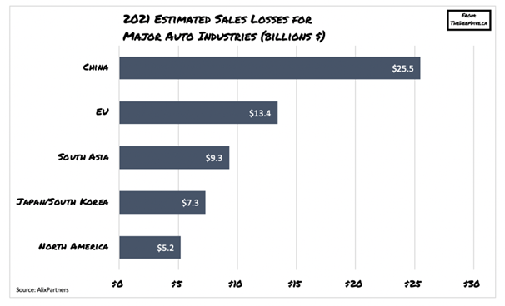
Control
It ıs obviously seems that building a new chip factory is more advantageous when economic, time and other factors are compared.
Figure 11: The chip crisis has affected every part of the world. Thus it became a universal problem. In the 21st century, when we live at the most advanced level of technology in the world, many countries that appear in the table have experienced a decrease in their sales.

Slide 19
Looking at the table above, the annual losses due to the chip crisis in the world in 2021 are 60.7 billion dollars, while the cost of establishing a new factory is 20 billion dollars. The construction of the factory is expected to take approximately 2 years. thus, in 2023, it may be able to meet new factory chip orders. Already, experts predict that the chip crisis will end in 2023.

Slide 20
Prepared by
Ferhan Sonkaynar 18069053
Ayşe Yeşil 18069015
Sıla Yıldırım 19069027
Nazlı Yağmur Taze 19061055

